Slide 1

Decisions in VBA
Week 5- Days 18-20

Slide 2
Decisions: What if “it depends”?
Excel has the IF function
VBA has the If-Then-Else structure
Each makes a logical test, and the result depends on whether the test is True or False (Boolean logic)

Slide 3
Recap: Decisions in Excel
Syntax for IF function
=IF(Condition, Value when condition is true, Value when condition is false)
Condition is the logical test, like “x ≥ 0”
The Values can be any valid Excel number, text, or formula
Logical Operators in Excel
= is equal to > is greater than, >= greater than or equal to < is less than, <= less than or equal to <> not equal to

Slide 4
Decisions in VBA
Syntax for If-Then-Else structure
If condition Then statements to do if condition is true Else statements to do if condition is false End If
Logical Operators in VBA (same as Excel)
= is equal to > is greater than, >= greater than or equal to < is less than, <= less than or equal to <> not equal to

Slide 5
Decision Syntax Example
In VBA:
If condition Then statements to do if true Else statements to do if false End If
fun_52(x) = 1 if x ≥ 0 fun_52(x) = 0 if x < 0
In Excel:
=If (condition, value if true, value if false)
Let’s say x is in cell C12
=If(C12>=0,1,0)
Function fun_52(x) If x >= 0 Then fun_52 = 1 Else fun_52 = 0 End If End Function

Slide 6
Decisions: If-Then-Else In-Class Exercise #2
x
-10
2
-5
0
1
4
-6
12
50
0
-35
-25
-17
48
Repeat the problem we did in Excel using If-Then-Else decision statements in VBA
For the values of x shown in the table , evaluate the function fun_52(x) using a VBA function
fun_52(x) = 1 if x ≥ 0 fun_52(x) = 0 if x < 0

Slide 7
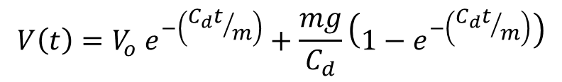
In-Class Exercise #3
The velocity of a skydiver can be described by the following equation:
The skydiver is initially in free-fall and deploys his parachute at some time, t_{c}.
Write a VBA Function that uses the parameters given on the Excel worksheet to calculate the skydiver’s velocity vs. time. Plot the skydiver’s velocity vs. time.
$$V\left(t\right)=V_{o} e^{−\left({C_{d}t}/m\right)}+\frac{mg}{C_{d}}\left(1−e^{−\left({C_{d}t}/m\right)}\right)$$

Slide 8
Compound Conditions in VBA
In VBA: 0 ≤ x ≤ 3
The statements to do if… can be any valid VBA code, including another If-Then structure
All 5 lines of intended code are the statements to do if true for the first/outer If
This is also called a “Nested If-Then”
If x >= 0 Then
If x <= 3 Then statements to do if 0 ≤ x ≤ 3 Else statements to do if x > 3 End If
Else statements to do if x < 0 End If

Slide 9
Compound Conditions in VBA
Can we make this decision in a single line of code? 0 ≤ x ≤ 3 Use a compound logical operation
AND operator condition → condition#1 AND condition#2
The AND operator gives a value of True only if both of the conditions are true, if not the value is False
OR operator condition → condition#1 OR condition#2
The OR operator gives a value of True if either of the conditions are true, only if both are False will the answer be False
NOT operator
The NOT operator reverses the result of any other logical operations

Slide 10
Compound Conditions in VBA: Syntax Example
In VBA: g(x) = 2x when 0 ≤ x ≤ 3
Use the AND operator as part of the condition in our If-Then-Else structure
If x >= 0 And x <= 3 Then g = 2 * x Else g = 0 End If

Slide 11
Compound Conditions in VBA
Other examples of Compound operations:
AND operator If Score > 90 And Rank < 10 Then
OR operator If Cost <= 1000 Or Mass < 10 Then
NOT operator If Not( Sal > 50 Or Com <= 10 ) Then

Slide 12
Multiple Decision Outcomes in VBA
y = one thing if 0 ≤ x ≤ 3, or y = other thing if 3 < x ≤ 10 – multiple compound decisions!
Add the ElseIf structure to our If-Then-Else
Can add as may ElseIf statements to the structure as we need!
Statements after the final Else are only done if ALL If and ElseIf conditions are False
If condition#1 Then statements to do if condition#1 true
ElseIf condition#2 Then statements to do if condition#2 true Else statements to do if both condition#1 and condition#2 false End If

Slide 13
In-Class Exercise #4
For the values of x shown in the table, evaluate the function
x
-1
-2
9
11
-5
6
2
-5
15
0
fun_54(x) = 2x when 0 ≤ x ≤ 3, or
fun_54(x) = (x – 3)² + 6 when 3 < x ≤ 10
If x is not between 0 and 10, then display the message “out of range” in the cell

Slide 14
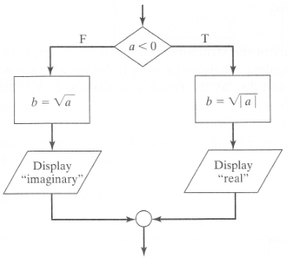
In-Class Exercise #5
Write a VBA Sub procedure that reads gets a number from the user and displays the square root of that number, also indicating whether or not the square root is imaginary.
Use the flowchart given to help you get started

Slide 15
In-Class Exercise #6
Repeat the grading problem we did using the IF function in Excel…
If score greater or equal to 90, then final grade is “A”
If score is between 80 and 90 (including 80) , then final grade is “B”
If score is between 70 and 80 (including 70), then final grade is “C”
If score is between 55 and 70 (including 55), then final grade is “D”
If score is below 55, grade is “F”

Slide 16
In-Class Exercise #6 (cont.)
score
75
91
43
77
86
54
73
97
88
52
94
82
61
36
74
46
16
Write a VBA Function to evaluate grades for the following scores based the grading scale in the problem statement.

Slide 17
In-Class Exercise #7 (Bonus)
Write a VBA Sub procedure to convert angles in degrees or radians to the opposite unit and identify which quadrant the angle falls within.
Get user input for the angle’s value and the units
Hint: Instruct the user how to enter the units in your InputBox. (e.g, “Enter 0 for degrees or 1 for radians.”)
Make sure your If statement(s) can handle a user error
Write the angle in both units and the angle’s quadrant to the spreadsheet.

